Slide 1
The American Colonies
Why did people choose to come here?
Notes:
http://www.history.com/videos/the-mayflower#the-mayflower

Slide 2
Reasons to Colonize: Why leave your home country and move across the Atlantic?
Reason 1: Money!!!
Gold, lumber and trade motivated people
Most Middle and Southern colonies were formed for money
All failed until they learned to sustain themselves – how did they do this?
Reason 2: Religious Freedom
New England colonies were more for this reason (Massachusetts and Pennsylvania)
King would punish or execute anyone who didn’t worship how he liked
Pilgrims and puritans were the first to arrive

Slide 3
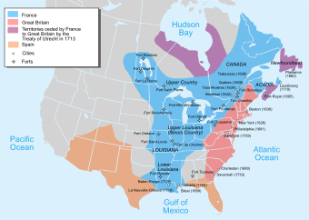
Where were the French & Spanish in North America?

Slide 4
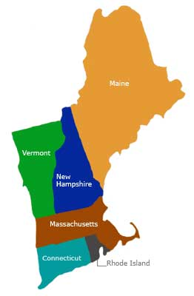
New England Colonies
Came more for religion than money
Not good soil or climate for farming
Lots of great waterways for fishing
Also began industry to build ships

Slide 5
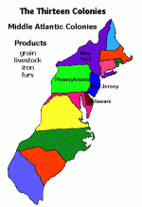
Middle Colonies
Pennsylvania & Delaware = more about religion
New York & New Jersey = more about money
Warmer Climate and fertile soil led to better farming
Small family farms grew wheat – became the “American Bread Basket”

Slide 6
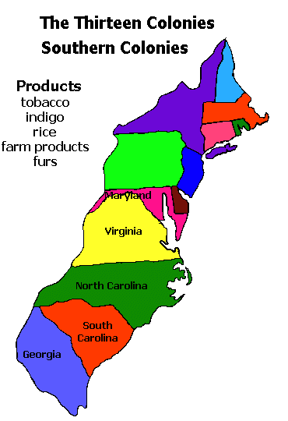
Southern Colonies
All came for money
Warm, humid climate led to long growing season
Tobacco, rice and sugar are high labor crops
Rich farmers bought up the best farm land on the coast and built large plantations = 50 or more slaves

Slide 7
The Atlantic Slave Trade
Between the years of 1500- 1800 10 million – 20 million enslaved Africans were brought to the colonies.
These were tribal people who had been defeated by other tribes and enslaved.

Slide 8
Continued…
To increase profits, slave ship captains crammed the maximum amount of enslaved Africans possible onto the ship.
Conditions were horrible for them. Hot, wet and crowded.
Because of the harsh conditions 15-20% of them committed suicide.
Notes:
http://www.youtube.com/watch?v=Mo79PHVI-ck&feature=related

Slide 9
Slavery in the Colonies
Southern Colonists wanted slaves because they could farm on a large scale and make large profits.
More workers = more production = more $$$
Slaves were bought and sold at auctions and treated much like any other farm equipment.
Slaves could be bought for $25-$2000. Strong, healthy slaves were more expensive than old slaves or slave children.
Slaves codes were laws that forbid the education of slaves. Owners wanted them to remain “like children” who needed to be cared for.

Slide 10
The Great Awakening
This movement brought ideas and religion from Europe to the colonies.
It occurred in the 1740’s under leadership of men like Jonathan Edwards.
It called for people to look at their lives and morals.

Slide 11
Enlightenment
John Locke
Humans have natural rights given to them by God – Government should protect them
Challenged the idea of the “divine rights” given to monarchs by God
Montesquieu
Powers of government should be defined and limited
Government should be separated into branches

Slide 12
Government in England – colonies duplicated it
Magna Carta “Great Charter”:
English nobels forced the King to sign it: Limited his power on taxes, private property & trail by jury
Parliament was established
House of Lords - inherited
House of Commons – elected
Could even remove kings sometimes
Glorious Revolution
Removed King James II and replaced him with his daughter Mary
She signed the English Bill of Rights expanding people’s freedoms, like Habeas Corpus.

Slide 13
Do you remember?
1.) What were conditions like on the boat coming to the colonies for enslaved people? (List two)
2.) John Locke believed in what idea?
3.) The Great Awakening forced people to examine what?
4.) What does “Separation of powers” mean?
5.) Could African-Americans attend school in the colonies? Explain your answer.
6.) Name two rights people were given by either the Magna Carta or the English Bill of Rights.

