Slide 1
Southern Plantation Tour
New Orleans, Summer or 2011

Slide 2
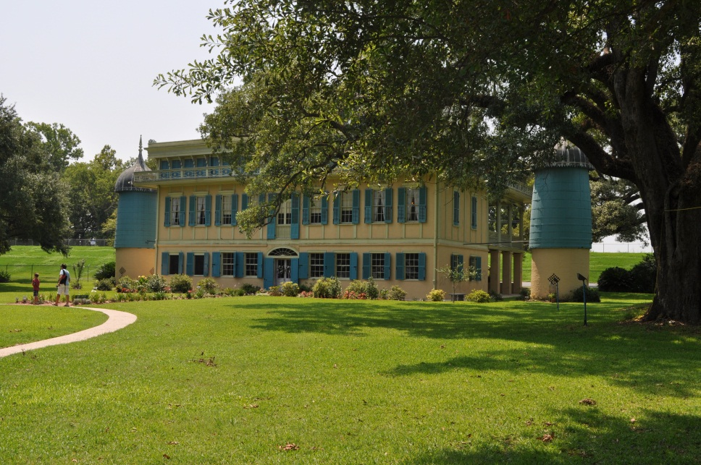
San Francisco Plantation
Sugar plantation built in late 1700s.
Silos on each side of house gathered rainwater from gutters for cooking and washing.
The water was run through sand to filter it.

Slide 3
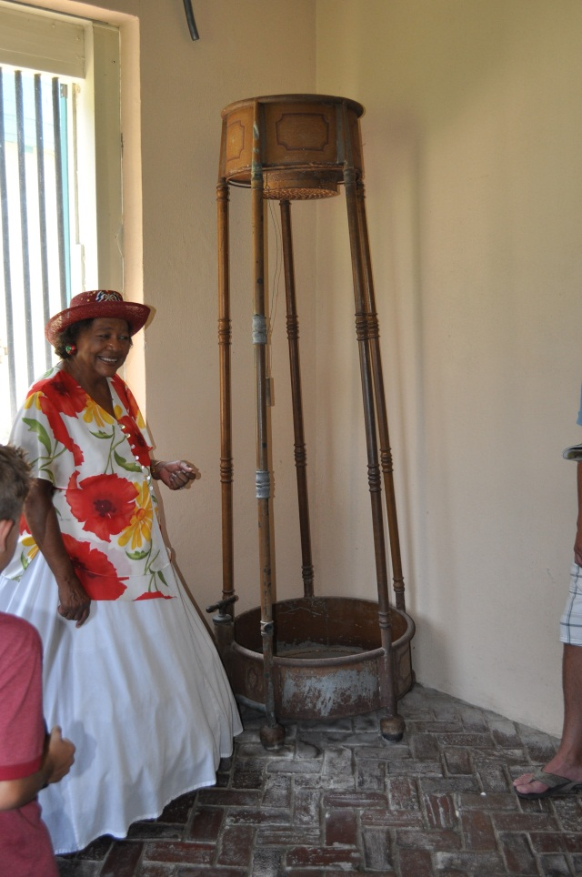
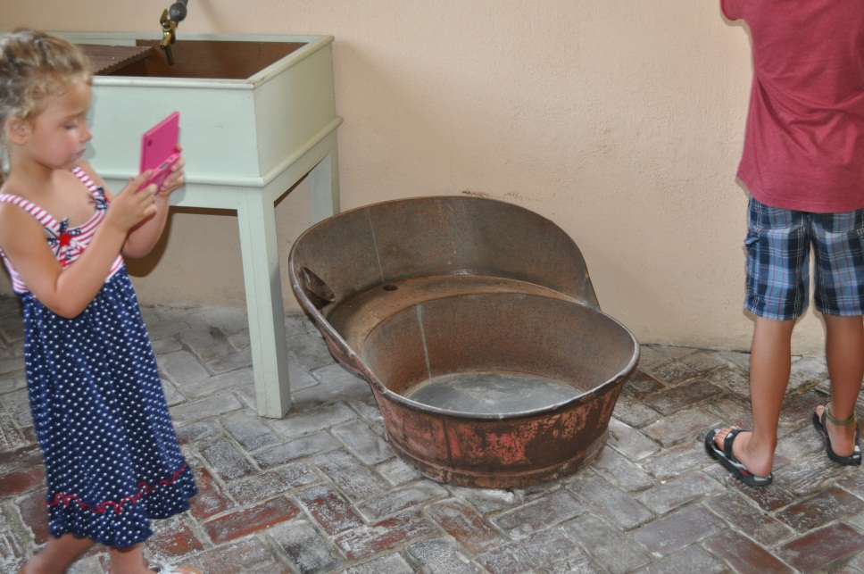
Men’s and Women’s Showers

Slide 4
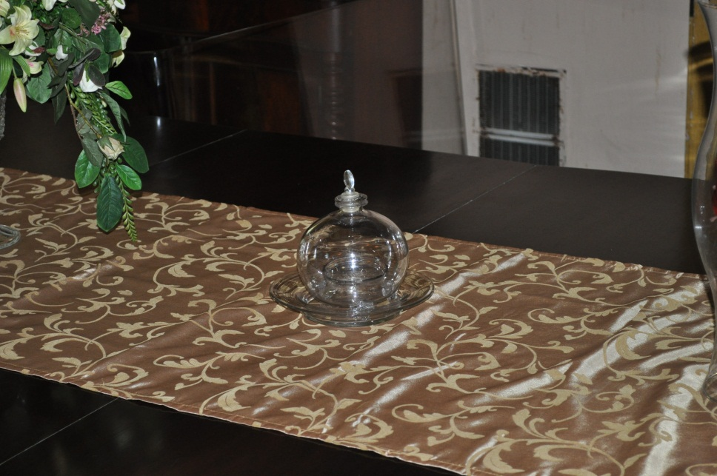
Dinner table
Used to catch flies: sugar water mixed with vinegar. A napkin would be placed over the dish while eating.

Slide 5
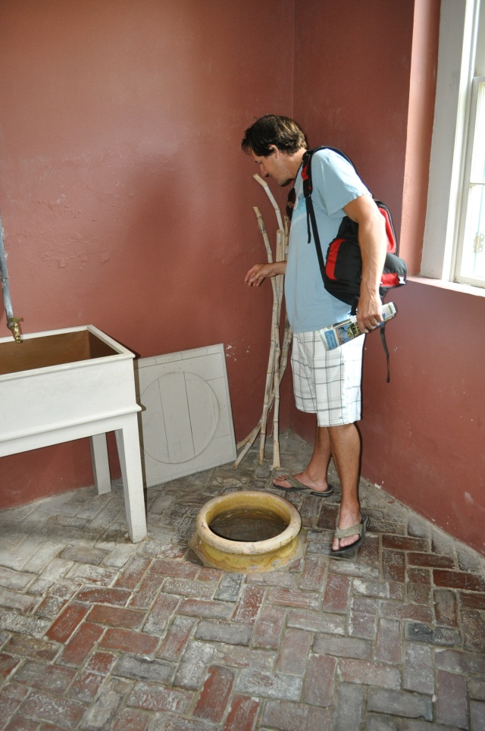
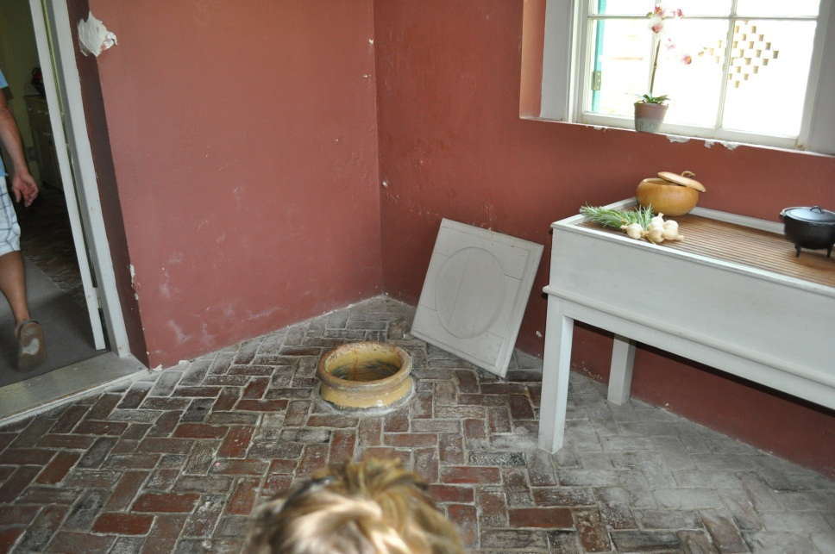
Kitchen - Refrigeration

Slide 6
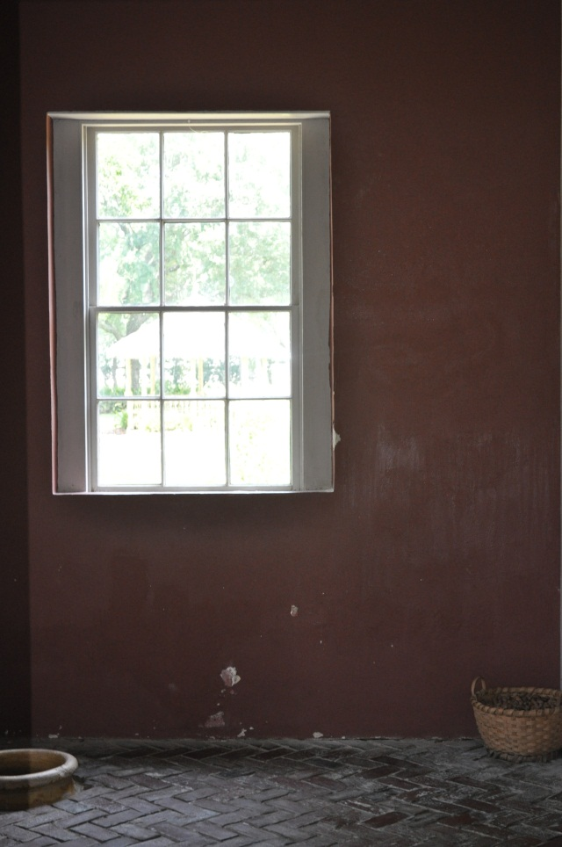
Whistling while walking food
Kitchen was a separate building many yards away from the main house. (To prevent fire damage to main house) Slaves would have to carry the food from the kitchen to the main house.
They were made to whistle so they couldn’t eat the food.

Slide 7
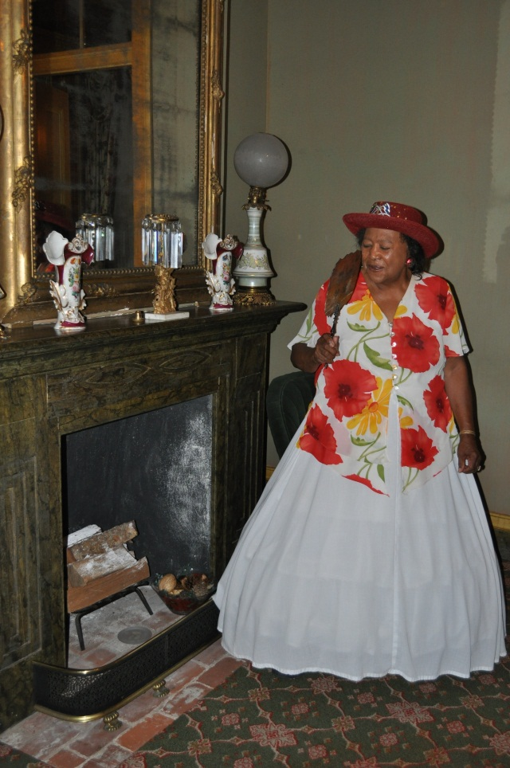
Beauty can be painful
Women would use bee’s wax to fill in wrinkles on face – the needed to shield their faces from the heat or it would melt off.
Fainting couch – corsets were so tights that the blood would rush to their heads went hey took them off and they would faint.

Slide 8
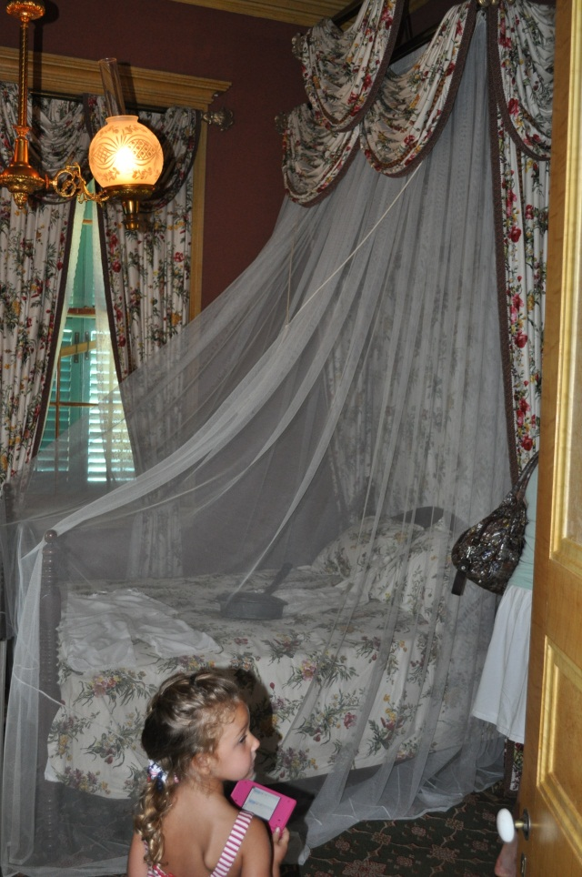
Children’s rooms
Nets meant to keep bugs off you while you slept.
Hot coals would be placed under the mattress to warm them on cold nights.
Ceilings would be painted blue to confuse wasps that would fly into the windows.

Slide 9
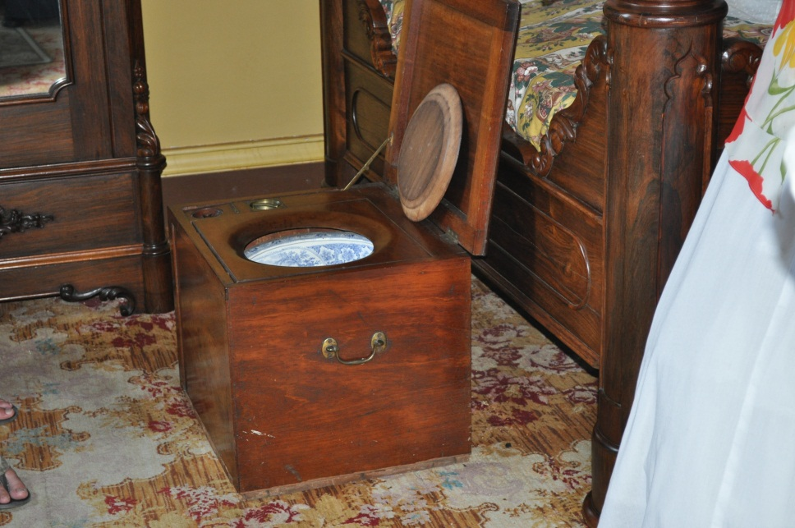
Chamber pot
This was a French household, so the faces of the English King and Queen were designed into the bottom of the chamber pots.
These were emptied by the house slaves.

Slide 10
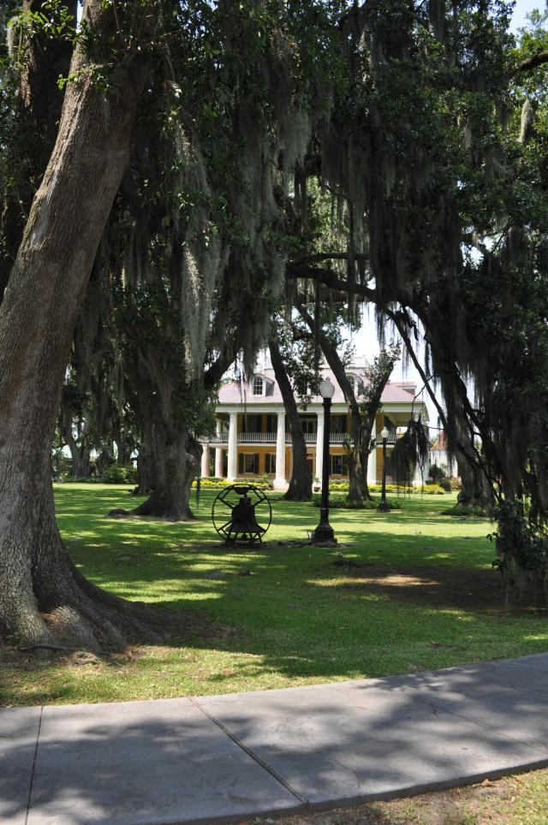
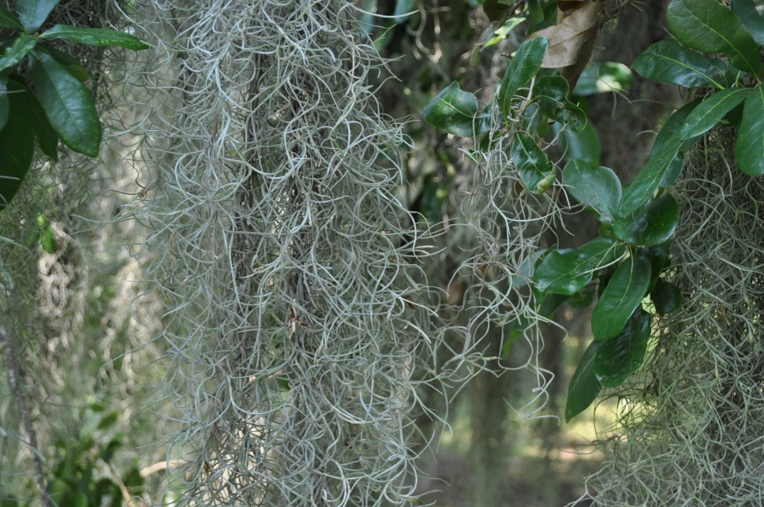
Moss used as stuffing

Slide 11
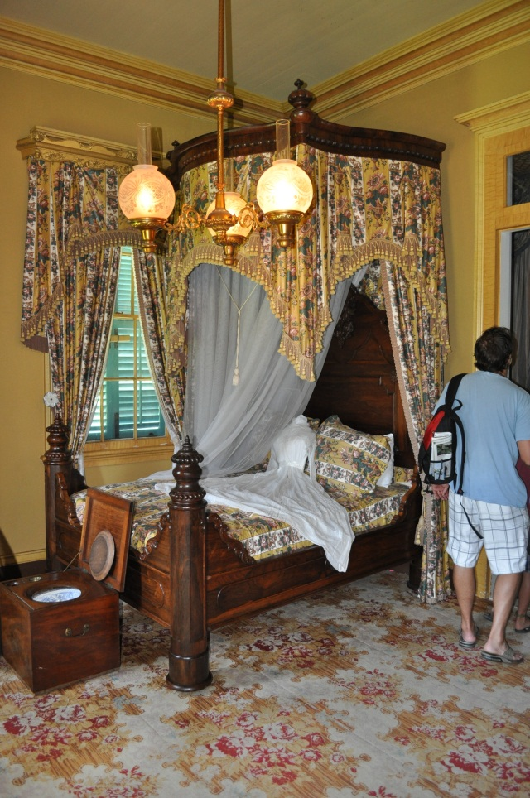
Moss used as stuffing
The mattresses were stuffed with moss from willow trees. It was boiled and stuffed into the mattress.
Henry Ford’s Model T’s used the same moss to stuff the seats, but it wasn’t boiled. Led to the 1st safety recall.

Slide 12
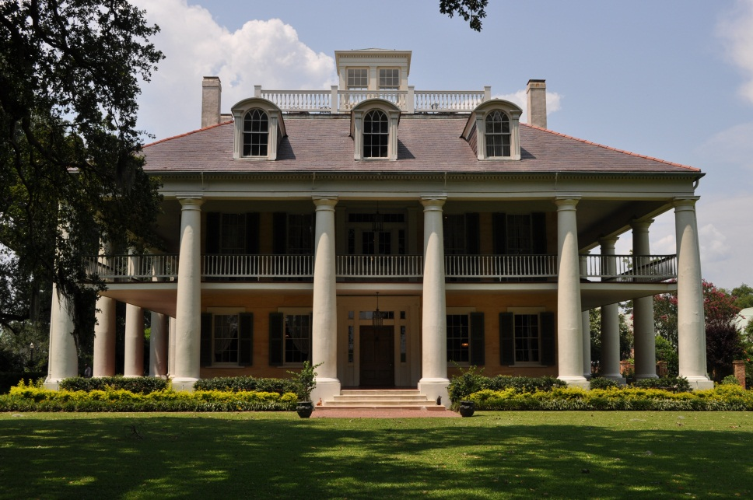
Houmas House
Construction on the Mansion was completed in 1828.
Ultimately grew to 300,000 acres
In late 1800's it was producing 20 million pounds of sugar each year.
It is reported to be haunted by the young daughter of a Civil War Colonel who dies of natural causes in the late 1800s

Slide 13
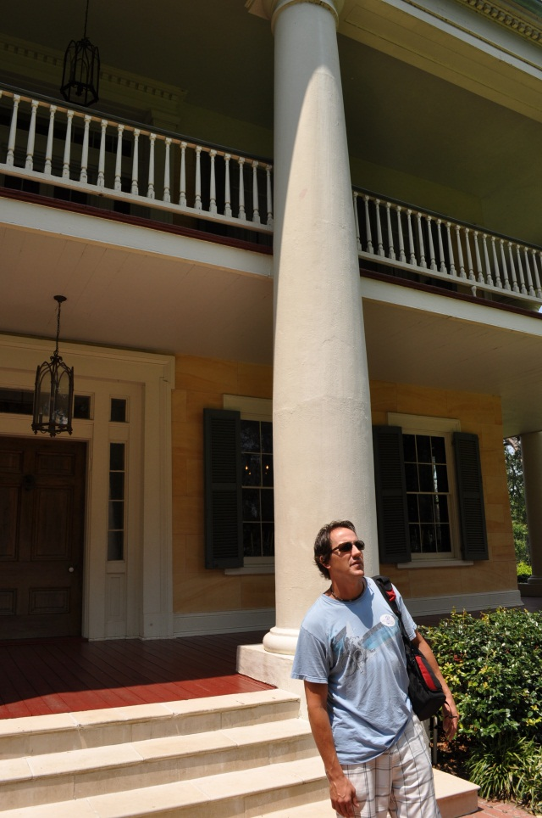
Cross Ventilation
Homes are build symmetrical – so that windows can be opened on all four sides of house and air flow will cool the house.
Doors are removable and very large doorways are built so that furniture can be moved out of the house for large balls and parties.

